Slide 1

Maintaining a global database of admin and postal boundaries with PostGIS
A large-scale use case for PostGIS topology
Benjamin Deswysen
Notes:
Maintaining a global database of admin and postal boundaries with PostGIS: a large-scale use case for PostGIS topology

Slide 2

Benjamin Deswysen
→ Geomatician @GeoPostcodes
Polleur (Liège, Belgium)
ULiege, UNamur
Geo data science & engineering
OSM occasional contributor
© Taïs Grippa - 2023

Slide 3
Global database of admin/postal boundaries with postgis topolgy
01
04
02
05
03
06
GeoPostcodes in a nutshell
Advantages of using postgis topology
Topology in GIS
Disadvantages of using postgis topology
Topology database: Postgis topology
Boundaries databases: admin and postal boundaries

Slide 4


01
GeoPostcodes
In a nutshell

Slide 5
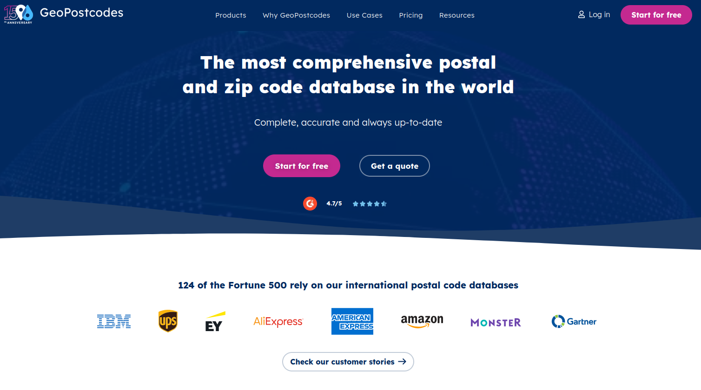

Slide 6
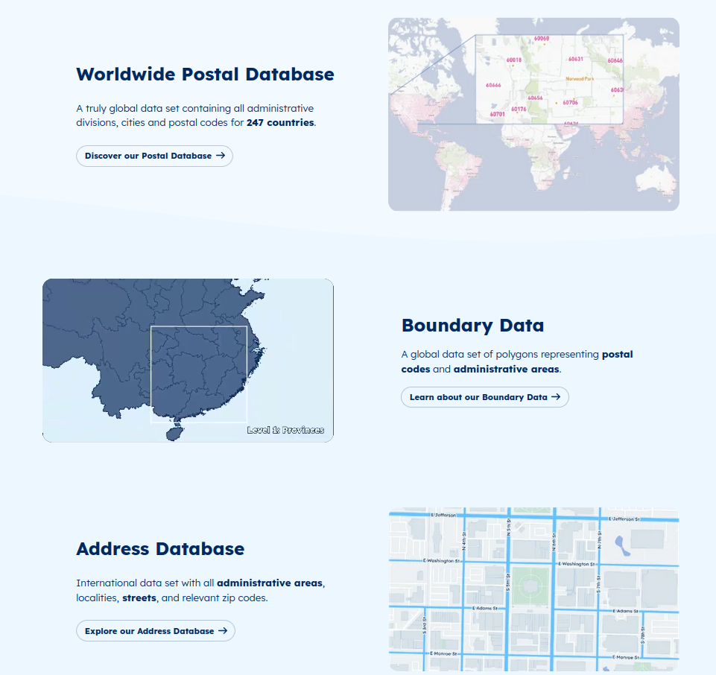

Slide 7
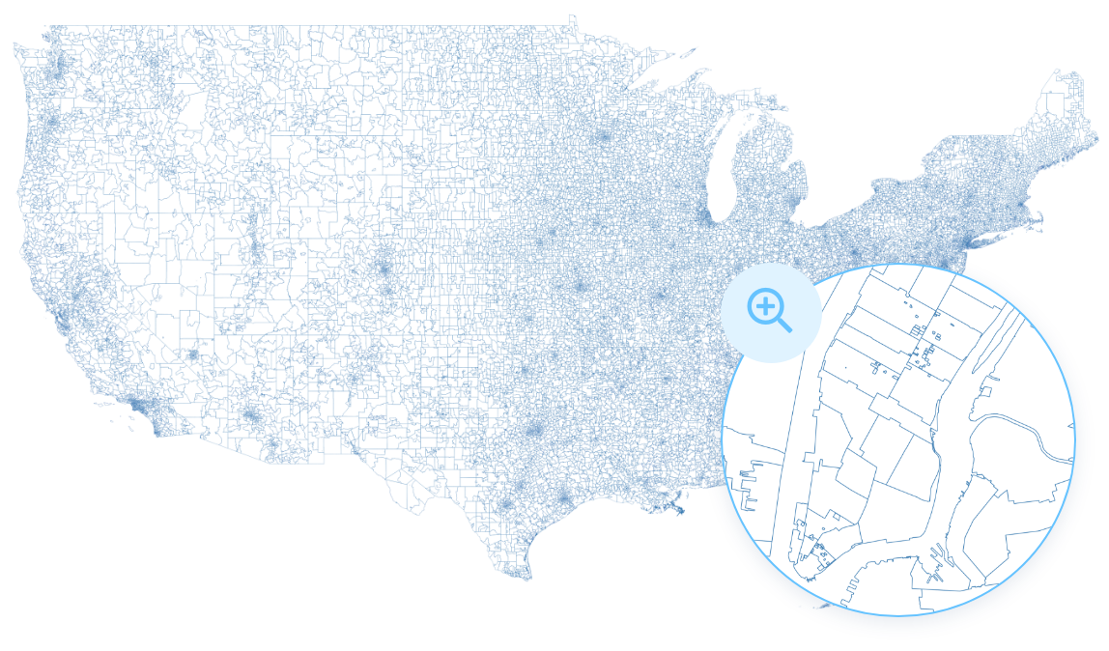
Boundaries database
“A collection of vector polygons representing either postal code or administrative division shapes.”

Slide 8
Boundaries database
“A collection of vector polygons representing either postal code or administrative division shapes.”

Slide 9
02
Topology in GIS

Slide 10
Topology expresses the spatial relationships between connecting or adjacent vector features (points, polylines and polygons) in a GIS.
https://docs.qgis.org/3.28/en/docs/gentle_gis_introduction/topology.html

Slide 11
Topology definition
Topology expresses the spatial relationships between connecting or adjacent vector features (points, polylines and polygons) in a GIS.
Topological or topology-based data are useful for detecting and correcting digitising errors (e.g. two lines in a roads vector layer that do not meet perfectly at an intersection).
Topology is necessary for carrying out some types of spatial analysis, such as network analysis.
Source: https://docs.qgis.org/3.28/en/docs/gentle_gis_introduction/topology.html

Slide 12
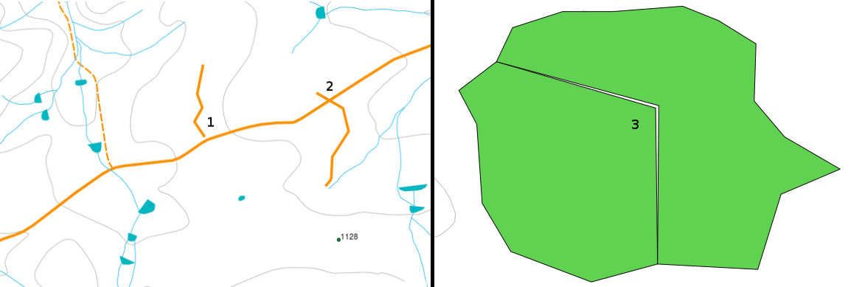
Topology errors
Undershoot: vector lines that should connect to each other don’t quite touch
Overshoot: line ends beyond the line it should connect to
Slivers: vertices of two polygons do not match up on their borders.
Source: https://docs.qgis.org/3.28/en/docs/gentle_gis_introduction/topology.html

Slide 13
Topology rules examples
Area edges of a municipality map must not overlap.
Area edges of a municipality map must not have gaps (slivers).
Polygons showing property boundaries must be closed. Undershoots or overshoots of the border lines are not allowed.
Contour lines in a vector line layer must not intersect (cross each other).
Source: https://docs.qgis.org/3.28/en/docs/gentle_gis_introduction/topology.html

Slide 14


Slide 15
03
Topology database
Postgis topology

Slide 16
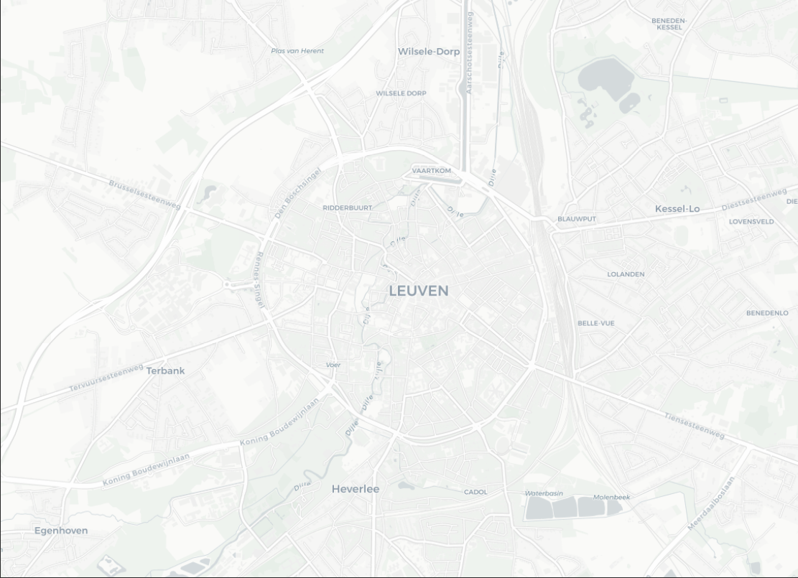
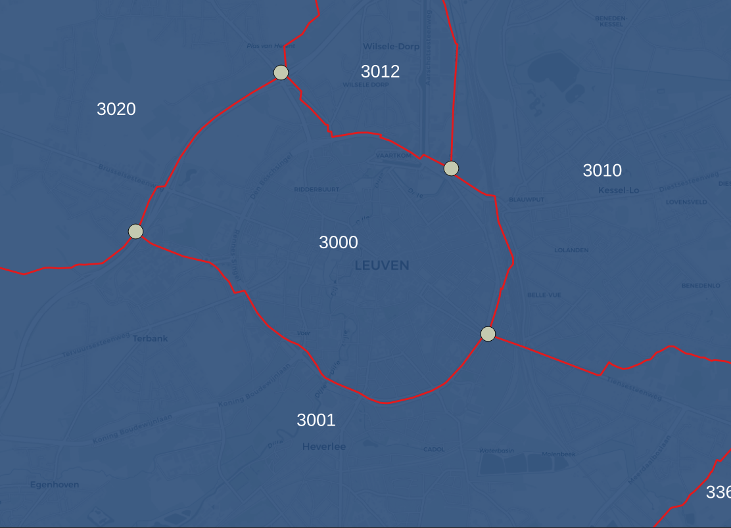
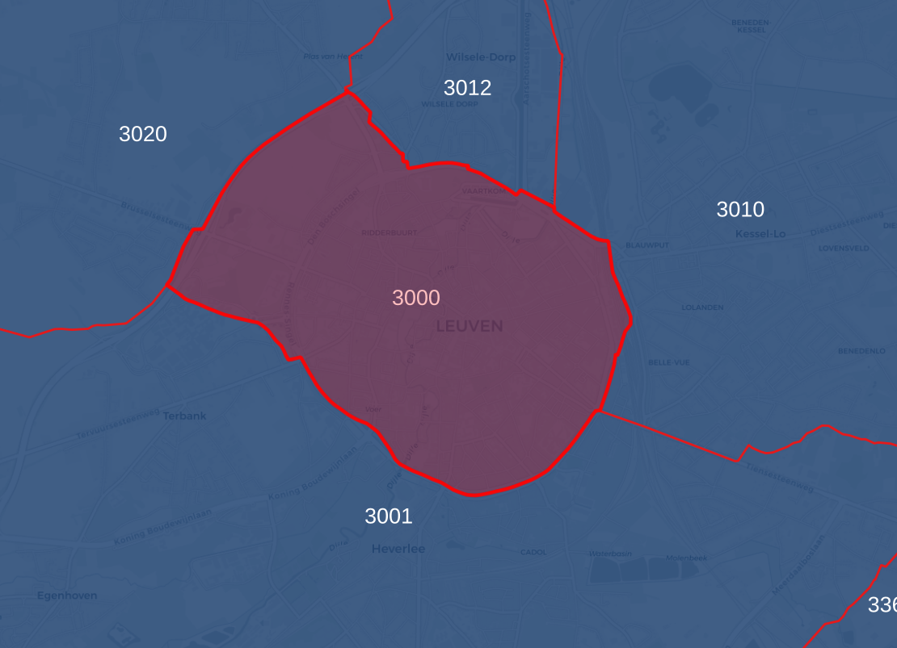
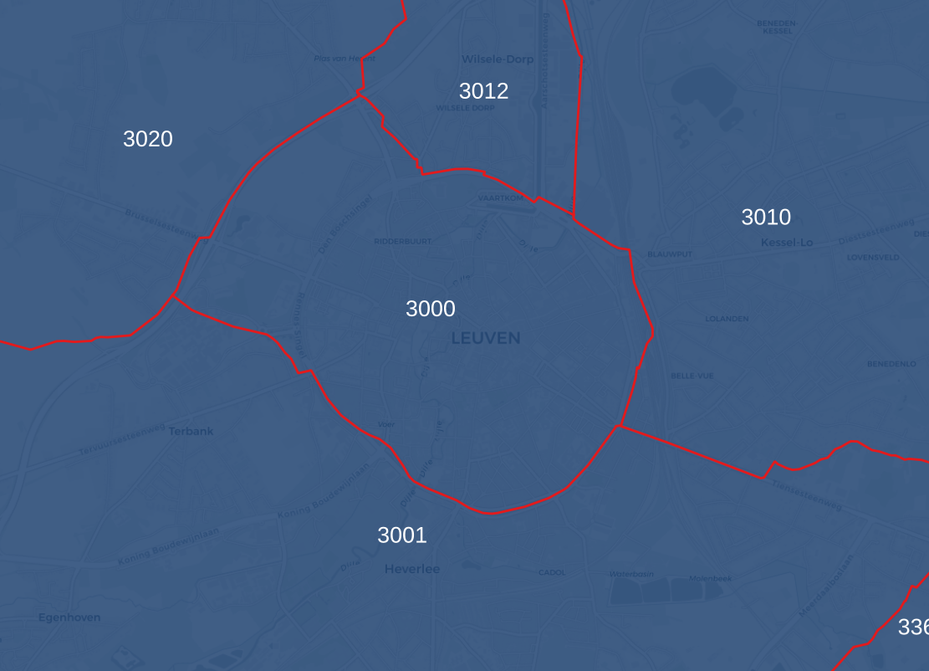
Example of polygon boundaries
1 Polygon
- 4 Edges
- 4 Nodes

Slide 17

GIS topology = outgrowth of graph theory
It’s a graph!

Slide 18
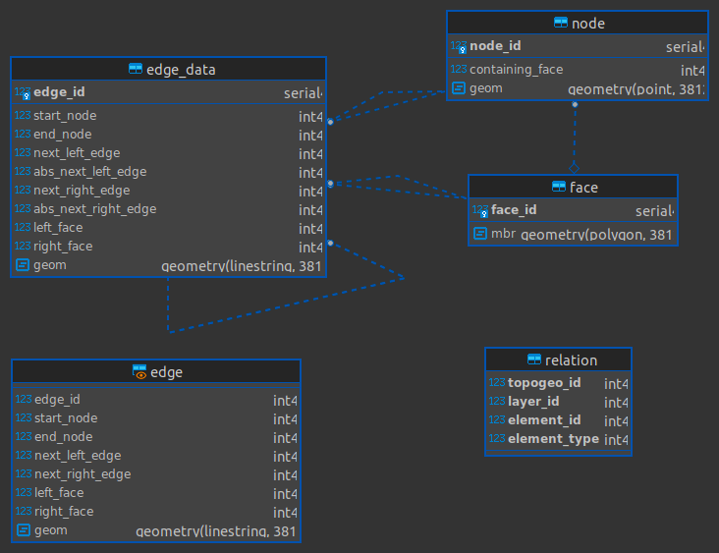
Postgis topology datamodel
“points”
“polygons”
“lines”
=> Topological primitives

Slide 19
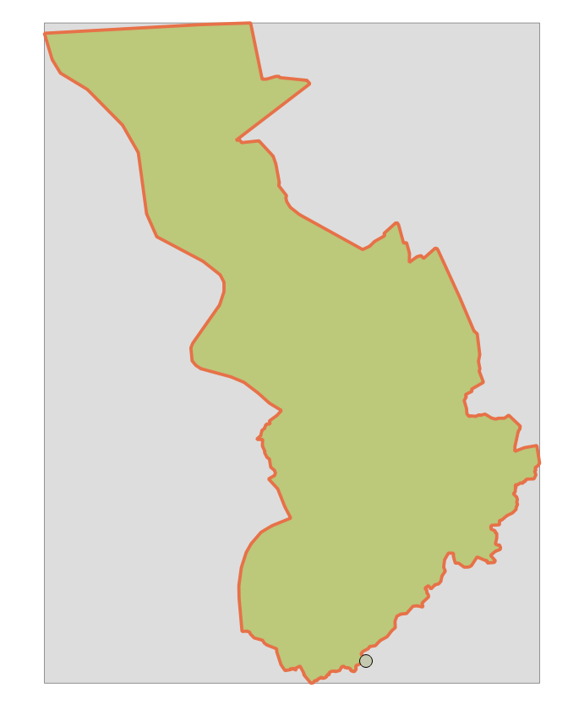
Postgis topology datamodel
Edge
Face
Node

Slide 20
04
Advantages of using postgis topology

Slide 21

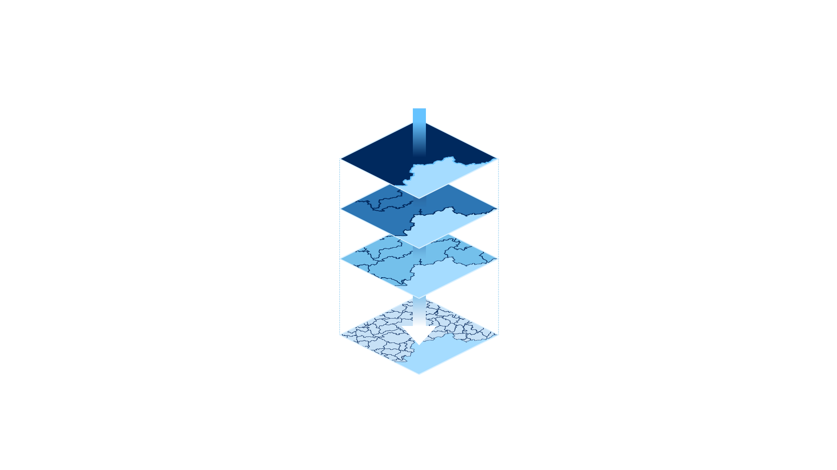
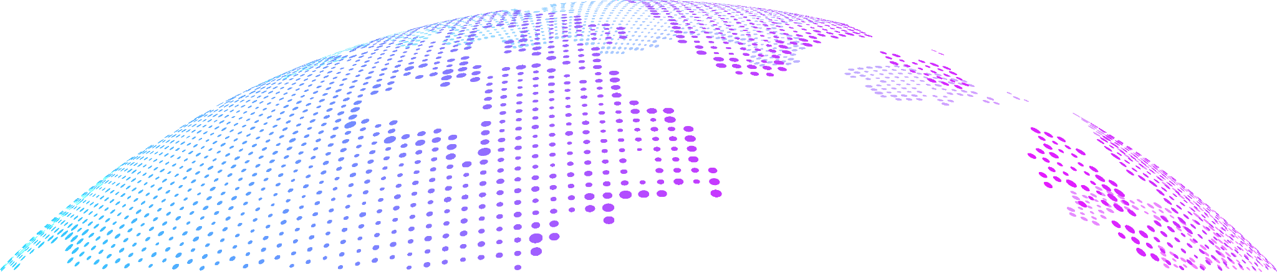
Nested boundaries
Store only once the delimitation
Automatic propagation of updates at all levels
Gaps/overlaps detection
Coherence between neighbour countries

Slide 22
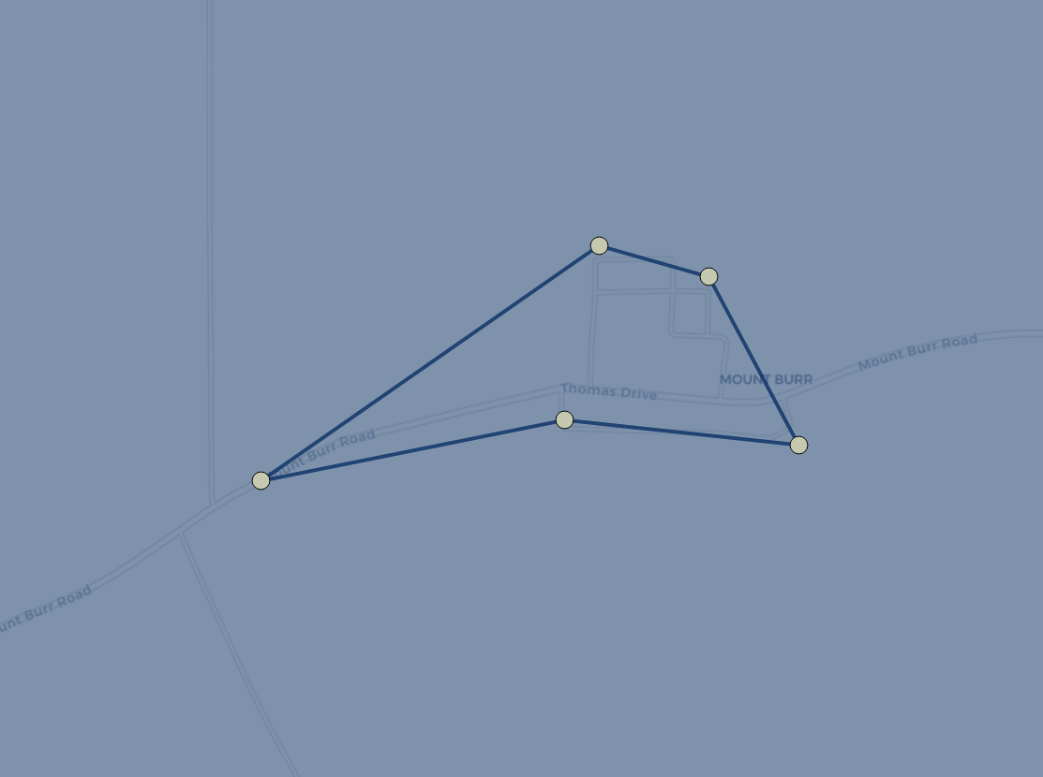
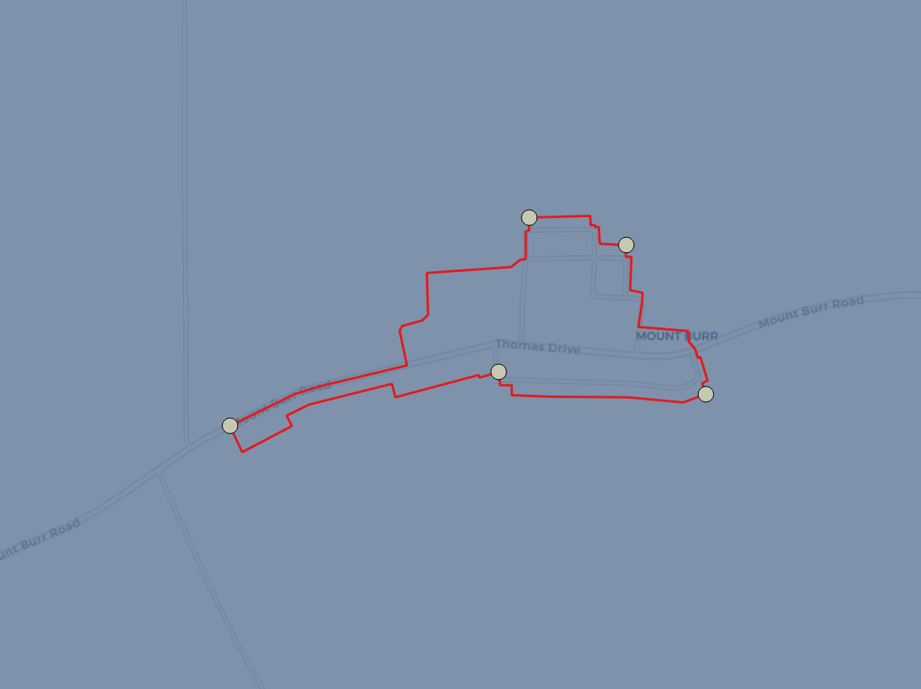
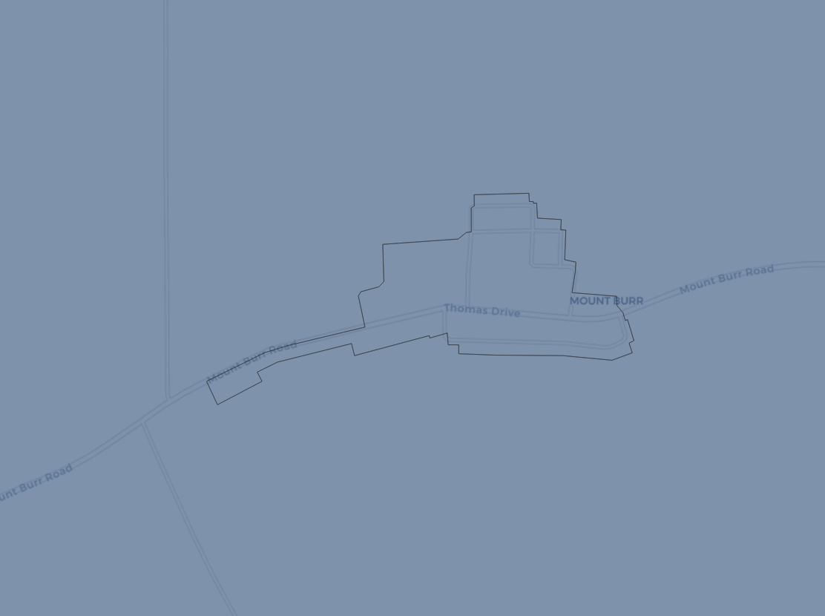
Polygon simplification (1)
1 Polygon - 5 edges - 5 nodes
Simplification
- 5 simplified edges
- 5 nodes

Slide 23
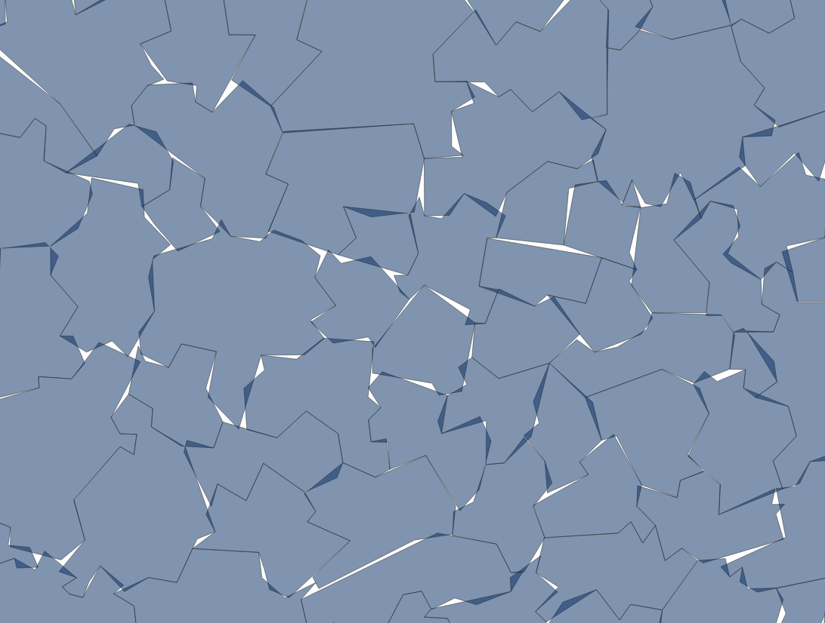

Polygon simplification (2)
Without topology
With topology

Slide 24
05
Disadvantages of using postgis topology

Slide 25
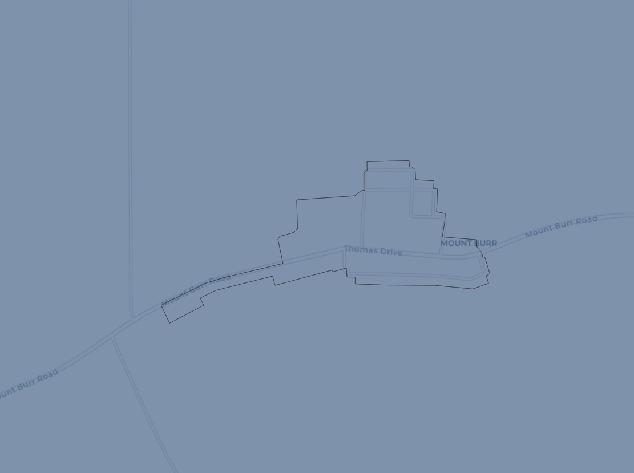
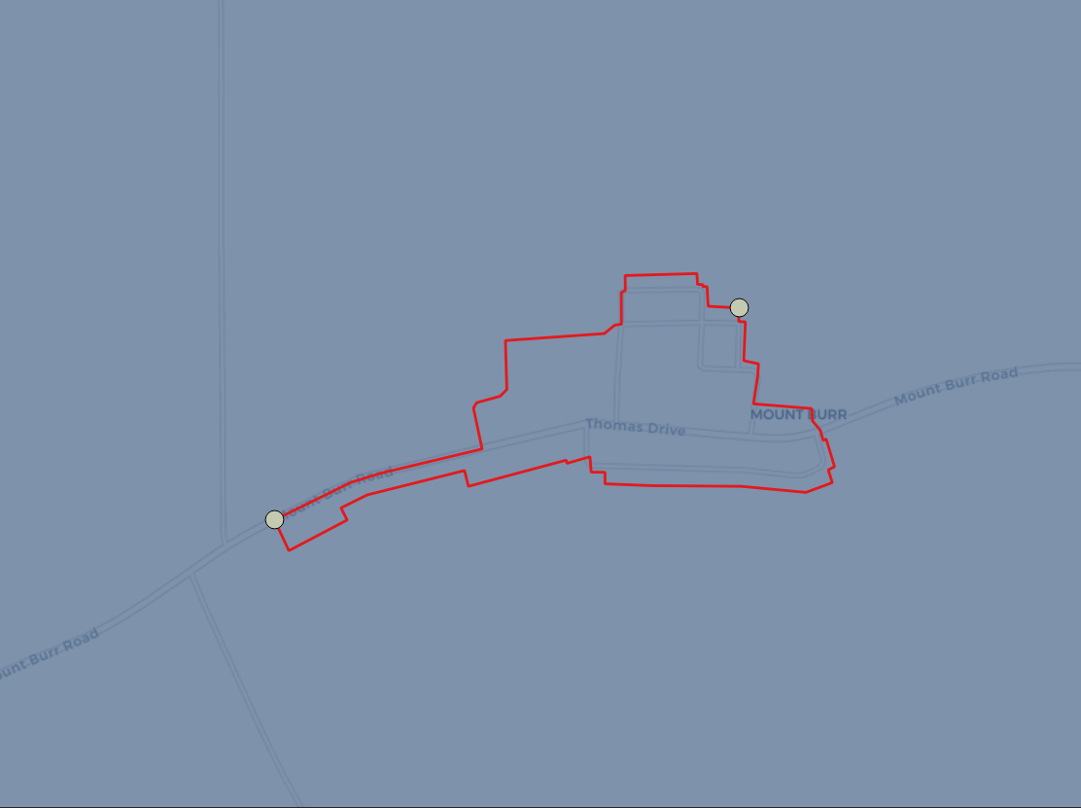
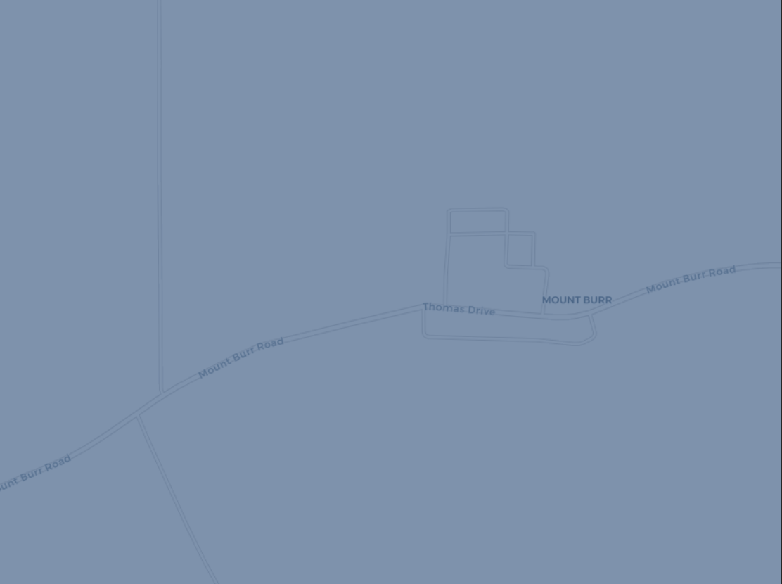
Oversimplification (1)
1 Polygon - 2 Edges - 2 Nodes
Simplification
→ Oversimplification = Empty geometry!

Slide 26
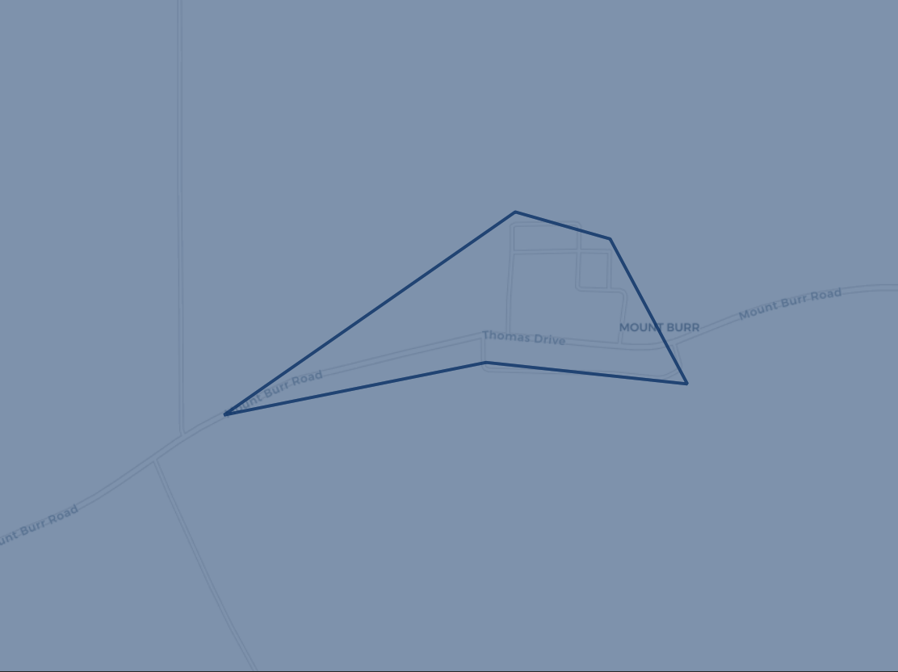
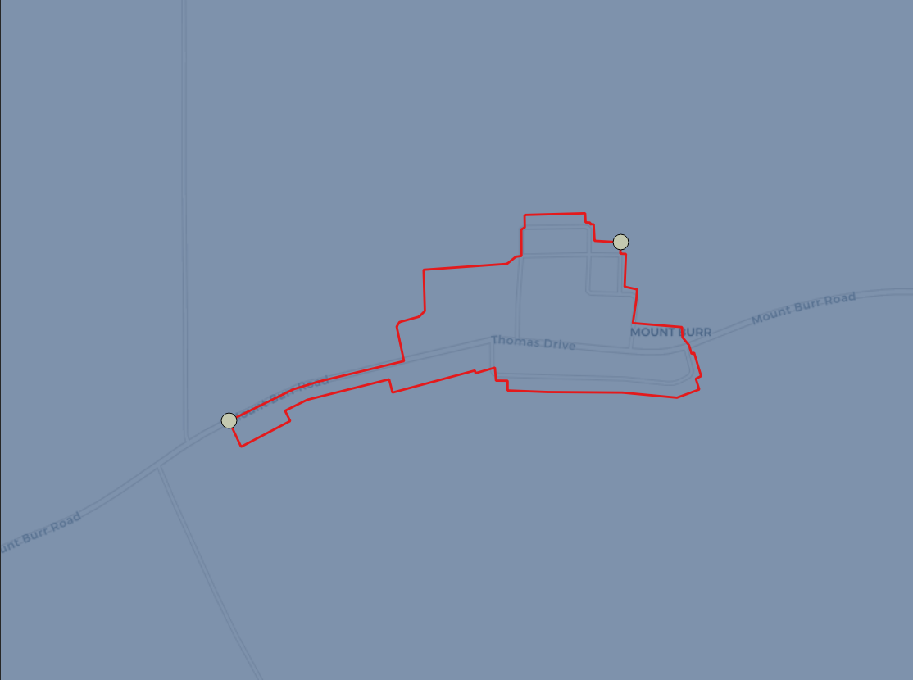
Oversimplification (2)
1 Polygon - 2 Edges - 2 Nodes
Densify topology - 5 Edges - 5 Nodes
Simplification

Slide 27
A capricious tool requiring custom developpements
Custom developpement required: add, delete, update topogeometries
Unhandled exceptions in core functions
Vulnerable to topologically unclean input data
Limited documentation and examples on the Internet

Slide 28
06
Boundaries databases
Admin & Postal boundaries

Slide 29

Admin boundaries
247
923 k
Countries
244 k
Nodes
1.2 M
Admin entities
Edges

Slide 30
Postal boundaries
170
2.16 M
Countries
643 k
Nodes
3 M
Zip / postal codes
Edges

Slide 31

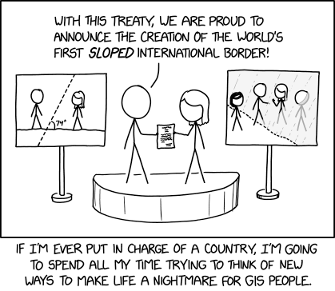
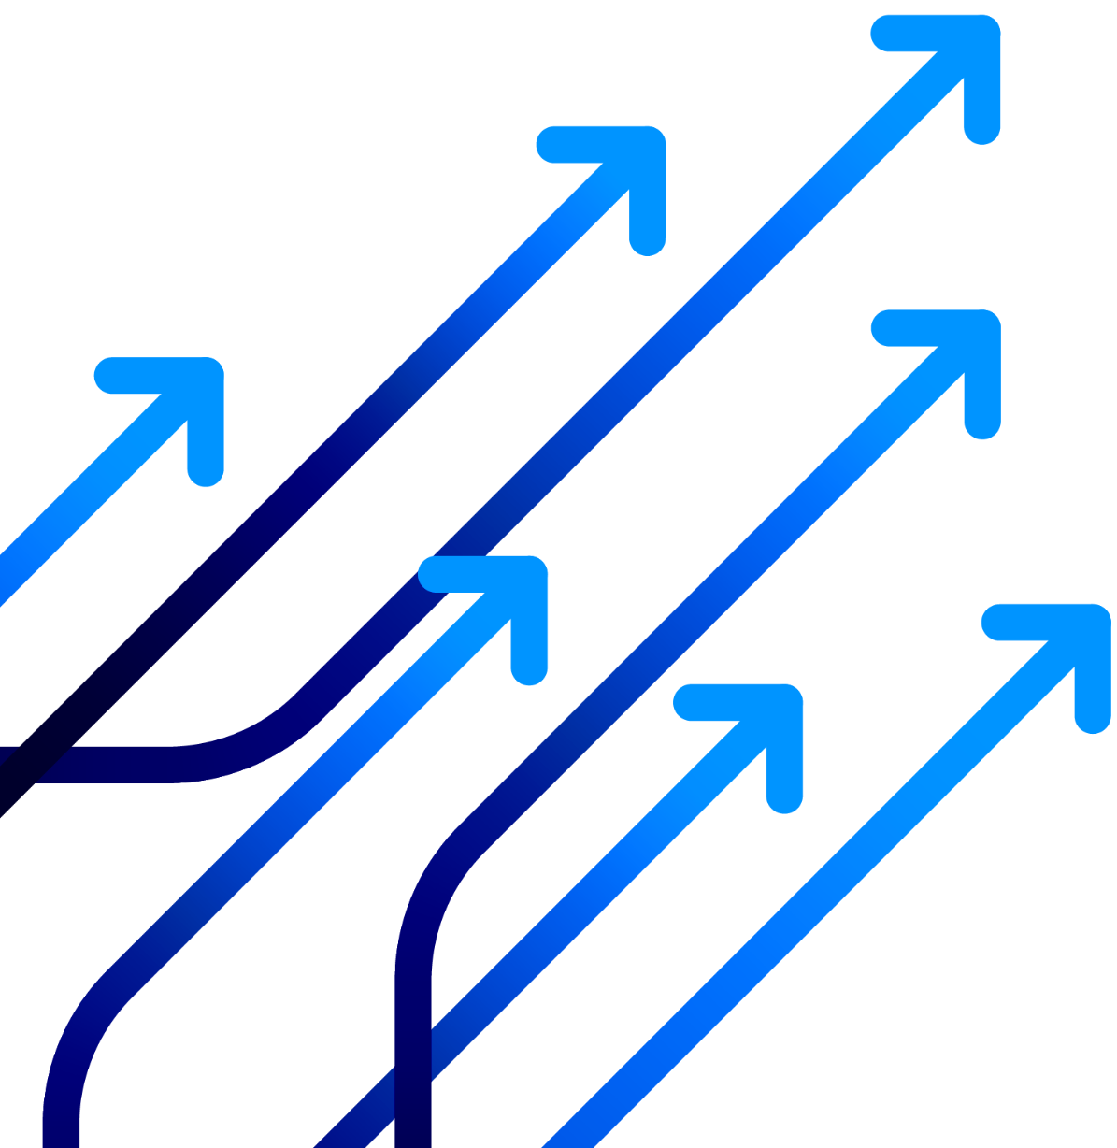
Thank you for your attention!
Source: https://xkcd.com/2519/

